Slide 1
Welcome to
SNAPA Teaches Tuesday

Slide 2
Welcome and Introduction
Pamela Gallagher, SNS, MBA
Executive Director
The School Nutrition Association of Pennsylvania
Elaine McDonnell,MS, RDN Assistant Research Professor Director, Project PA Penn State University Department of Nutritional Sciences

Slide 3
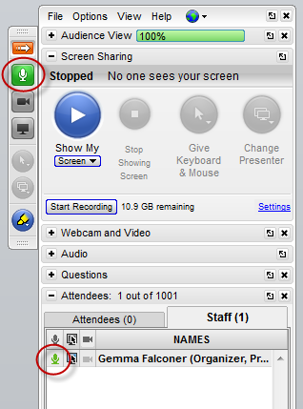
Go to Webinar
Control Panel
Type your questions into the “Question” box at any time during the webinar.
Questions will be addressed as time allows.

Slide 4
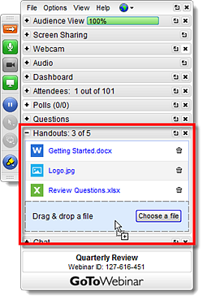
Go to Webinar
Control Panel
Handouts are found using the
Go to Webinar
Control Panel

Slide 5
Webinar and Handouts
Webinar recording and copies of all the handouts will be posted on the SNAPA website and available to SNAPA members.
Members will need their username and password to access the recorded webinar.
SNAPA Website Link
https://snapa.org/resources/webinars/webinars

Slide 6
Making the Most of Your Training Opportunities Through Project PA
Elaine McDonnell, MS, RD
Director, Project PA
Penn State University
Department of Nutritional Sciences
etm101@psu.edu
814-865-5869
www.projectpa.org

Slide 7
Project PA
Collaboration between PA Department of Education, Division of Food and Nutrition, and Penn State University
Began in 1995 as a two-year project to address training needs related to the School Meals Initiative for Healthy Children.
www.projectpa.org

Slide 8
Project PA
Topics
Meeting meal pattern/nutrient standard requirements
Wellness Policies
Smarter Lunchrooms
School Breakfast
Environmental Strategies
New Food Service Directors
Culinary Training
Connecting cafeteria, classroom, and community
Professional Standards
Farm to School

Slide 9
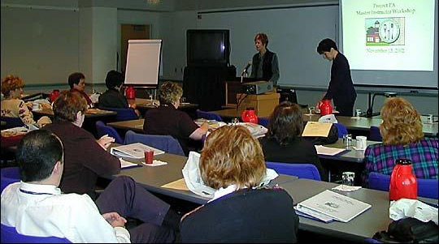
Project PA
Training strategies:
Teleconferences
Videos
Train-the-trainer program
Conferences
Website
Mini-grants
Workshops/presentations
Mentor programs
Webinars
On-line modules

Slide 10
Project PA
Current/Future Projects
School Nutrition Toolbox
Training for New School Food Service Directors
School Breakfast Outreach and Education
Training for CACFP Sponsors
Culinary Training
Farm to School

Slide 11
School Nutrition Toolbox houses 22 modules related to operating school meal programs
Free web-based training
Target audience: Individuals with responsibilities related to school meals
www.schoolnutritiontoolbox.org

Slide 12
Benefits of Web-Based Training
Convenient
Cost-effective
Standard
Authoritative
Provides professional development

Slide 13
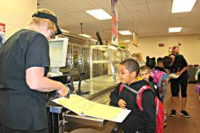
Administrative Training Modules
Determining Eligibility for Free/Reduced Price Meals
Verification of Eligibility
Meal Counting and
Claiming

Slide 14
Annual Training Modules
School Nutrition Program Annual Training
RCCI Annual Training

Slide 15
Other Modules:
Administrative Review
Afterschool Snack Program
Breakfast: The Most Important Lesson of the Day
Civil Rights
Crediting in School Meals
Farm to School: Keeping it Safe
Forecasting
Fresh Fruit and Vegetable Program
Marketing School Meals

Slide 16
Other Modules:
Offer Versus Serve
Overview of School Nutrition Programs
Procurement
Production Records
School Breakfast Meal Pattern
School Lunch Meal Pattern
Serving Students with Disabilities in School Meals
Smart Snacks in School

Slide 17
What does it include?
Pre/post-tests
Learning objectives
Course content
Practice questions
Activities

Slide 18
Requirements:
Annual Trainings
Required annually for all sponsors
Other Modules
May be required based on Administrative
Review outcomes

Slide 19
Certificates document completion:
Annual Trainings
Must get 90% correct on post-test or 100% on pre-test
Other Modules
Must get 80% correct on post-test
All Modules
Must view all pages to take post-test

Slide 20
Tips
School Nutrition is NOT related to PEARS or the Child Nutrition Toolbox.
You can save your work, logout, then return later to continue.
Multiple individuals from a school district may use the modules. Each must create his/her own account.

Slide 21
Tips
If you can’t find your e-mail confirmation of registration, check your Spam/Junk folder. It may not arrive instantly. If you still can’t find it, contact Project PA.
Note: Please make sure you type your e-mail address correctly.

Slide 22
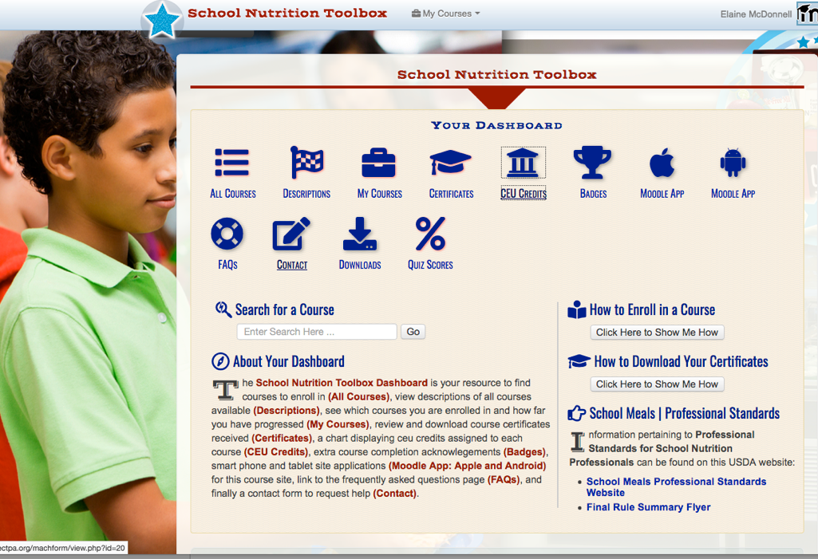
Tips
“Helper” enhancements:

Slide 23
Tips
Course Descriptions:

Slide 24
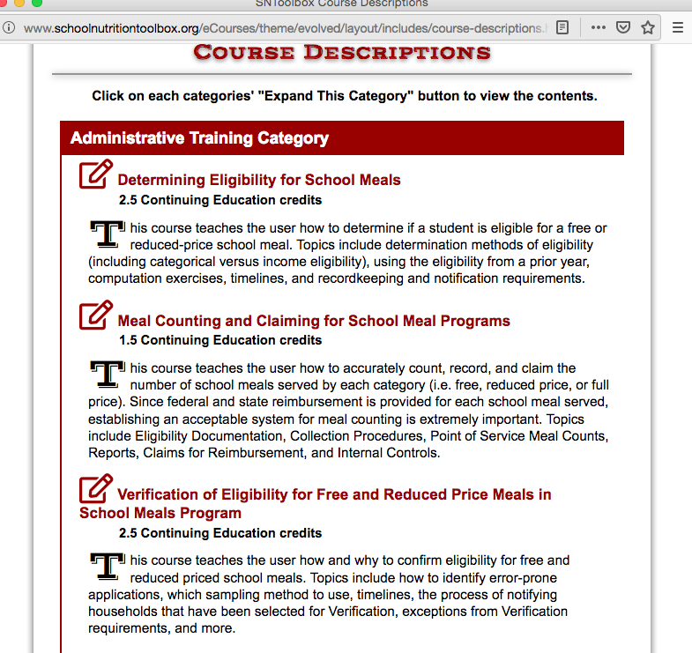
Tips
Course Descriptions:

Slide 25
Tips
Download Alternate Versions of Modules:

Slide 26
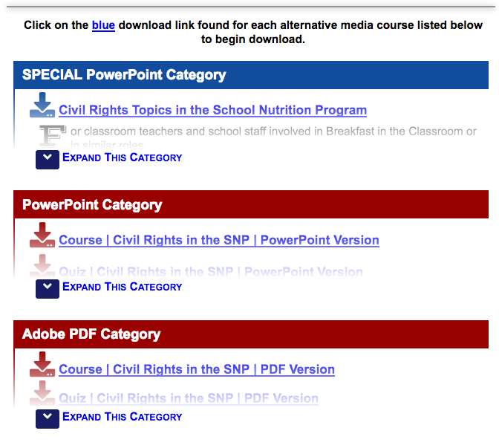
Tips
Download Alternate Versions of Modules:

Slide 27
Questions?

Slide 28
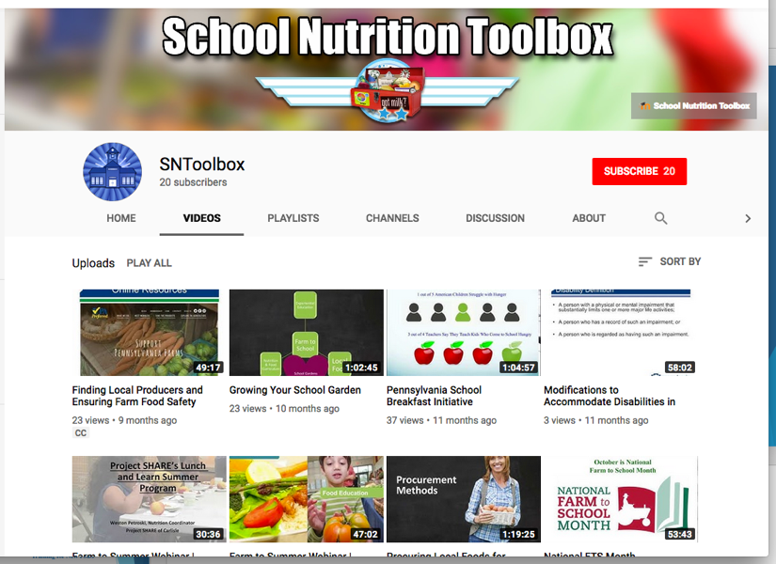
Webinars
Rebroadcasts –
Project PA website – www.projectpa.org
You Tube page - https://www.youtube.com/user/SNToolbox

Slide 29
Training for New FSDs
Annual 2-part Orientation Session
Part 1: October; Part 2: April/May
Harrisburg
1 ½ - 2 days

Slide 30
Training for New FSDs
Part 1
Meal Pattern/Menu Planning
USDA Foods
Direct Certification
Eligibility Determination
Verification
Production Records
Meal Counting and Claiming
PEARS
Project PA/SNT
Civil Rights
Procurement
Special Needs
SNP Financial Report
Paid Lunch Equity

Slide 31
Training for New FSDs
Part 2
Financial Management
Personnel Management
Summer Food Service Program
Wellness Policies
Professional Standards
Environmental/Biosecurity Management
Community Eligibility
School Breakfast
Food Safety
Farm to School
Marketing

Slide 32
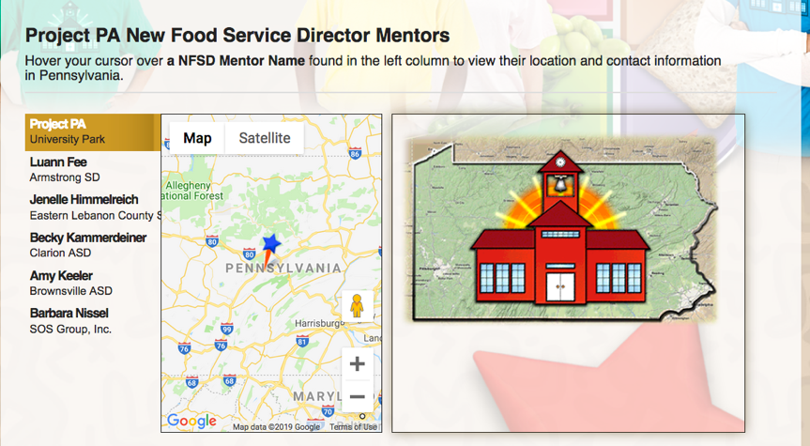
Training for New FSDs
Mentor Program -
Experienced SFS directors paired with new FSDs

Slide 33
School Breakfast Outreach/Education

Slide 34
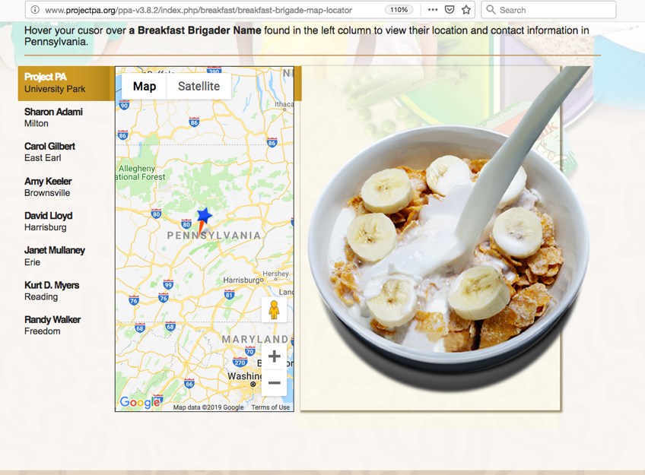
School Breakfast Outreach/Education
Breakfast Brigade

Slide 35
School Breakfast Outreach/Education
School Breakfast Webinars
School Breakfast Promising Practices

Slide 36
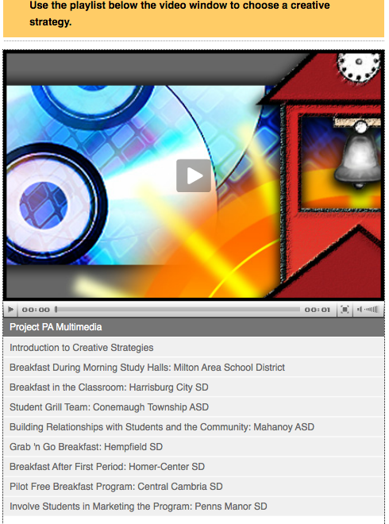
School Breakfast Outreach/Education
Creative School Breakfast Strategies –
Videos of alternative breakfast service methods
Project PA You Tube page and Project PA website
under “School Breakfast
Resources”

Slide 37
Training for Child and Adult Care Food Program Sponsors
Workshop: Crediting Foods in the CACFP
3 sessions; May 2019
Harrisburg and Pittsburgh
Culinary Training for CACFP sponsors
2 sessions (1/2 day); June 2019
Harrisburg and Pittsburgh

Slide 38
Culinary Training for SFS Professionals
2015 – 2017: 30 culinary training sessions conducted
Selected comments:
“This experience encourages me to follow my dreams about going to culinary school, getting my bachelor's degree, and one day becoming a food service director.”
“This was the most amazing training I’ve ever attended. Very inspiring.”
“This was the best experience in my 20+ years in food service.”

Slide 39
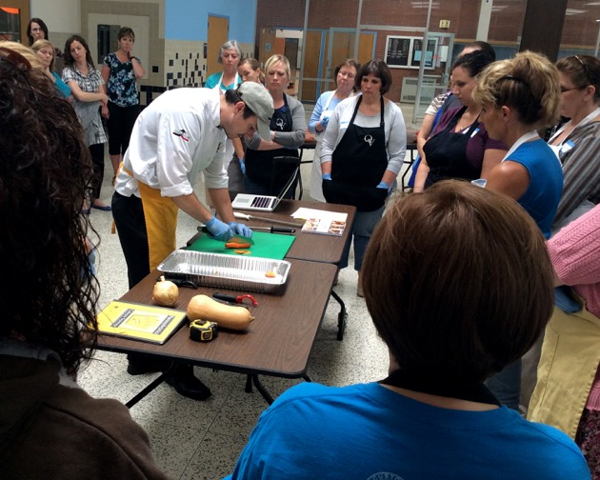
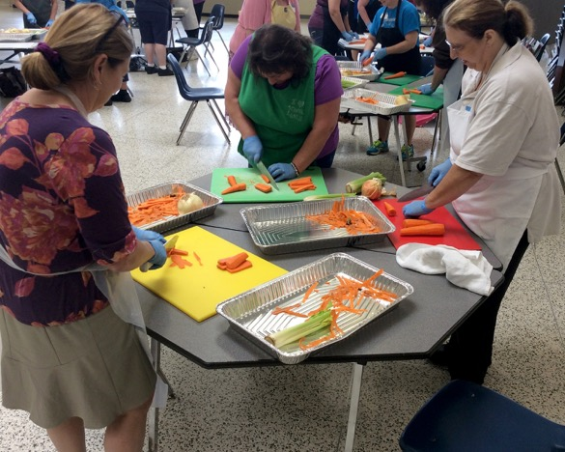
Culinary Training for SFS Professionals
Three 2-day sessions – Summer 2019

Slide 40
Farm to School
Website
On-line module
Webinars
“Promising Practices”

Slide 41
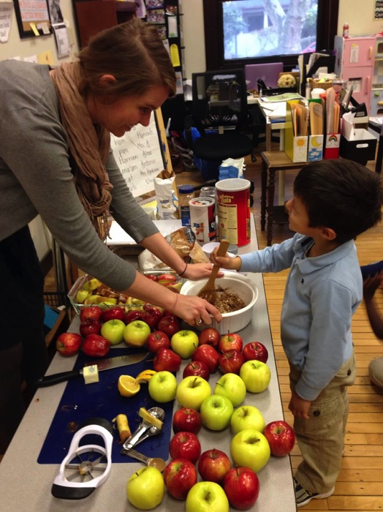
Farm to School
Promotional Events

Slide 42
Project PA Future Farm to School Work…
…Stay tuned!

Slide 43
Vision:
“Every Pennsylvania child engages with their local food system.”
“Monthly Harvest” e-newsletter
https://thefoodtrust.us6.list-manage.com/subscribe?u=c53e098aaf552969128409c33&id=de04a0cfe7

Slide 44
PA Farm to School Network Partner Events
Regional School Food Summit
April 10, 2019, 8:00am – 4:00pm
Grower/Buyer Networking Event (8:00am – 10:30am)
Chatham University, Eden Hall Campus, Gibsonia, PA
Pittsburgh Food Policy Council, Penn State Extension, and The Food Trust
https://www.pittsburghfoodpolicy.org/schoolfoodsummit
Questions? sarah@pittsburghfoodpolicy.org

Slide 45
Elaine McDonnell, MS, RD
etm101@psu.edu
814-865-5869
www.projectpa.org
www.schoolnutritiontoolbox.org

